Slide 1
Adversarial Event Detection with Bidirectional LSTM and CNN Model
Author: Sean Sica
Course: DATASCI 207
Date: 18 Apr 2024

Slide 2
Overview
Project Purpose:
Aim to enhance DDos detection tactics.
Problem Statement:
Rapid evolution of DDoS tactics; inadequacies of traditional security measures.
Objective:
Develop a ML model with high accuracy; minimal FP and FN
Develop a ML model that reasonably beats primitive OTS baseline models
Notes:
The purpose of my proejct is to enhance DDoS detection tactics.
Given the proliferation of IoT devices and consumer access to advanced AI, adversarial tactics are become more advanced and elusive.
To keep up with the rapid evolution of malicious techniques and tactics, I set of goal of developing a model that could perform multi-class classification with high accuracy and reasonably beat off-the-shelf baseline models.

Slide 3
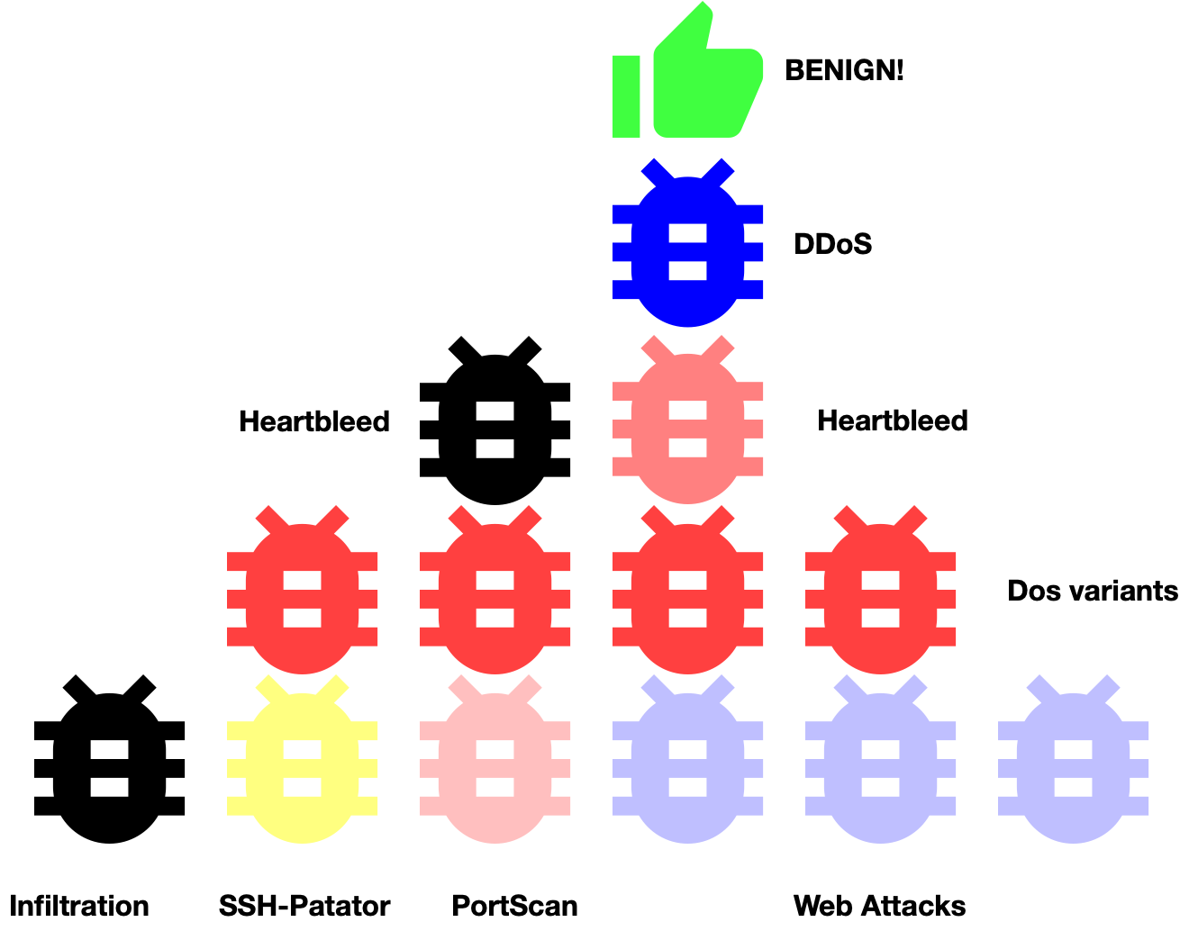
CIC-IDS2017 Dataset
Synthetic network traffic
Format:
–CSV (880 MB)
–PCAP (52.25 GB)
•Samples: 2,830,743
•Features: 80
•dtypes: int64 + float64
Notes:
As I mentioned during the midterm, I developed my model using a free-upon-request dataset called CIC-IDS2017.
Developed at the University of New Brunswick and comprising almost 3M synthetic packet samples, CIC-IDS2017 is considered one of the newest and more robust training datasets out there for sequential network traffic.
It contains benign traffic and 13 up-to-date common cyber attacks which resemble true/real world data as presented.
The dataset is provided in both PCAP and CSV format. The PCAP files entail the raw packets observed on the wire whereas the CSV are post-processed representations. One packet, one row.

Slide 4
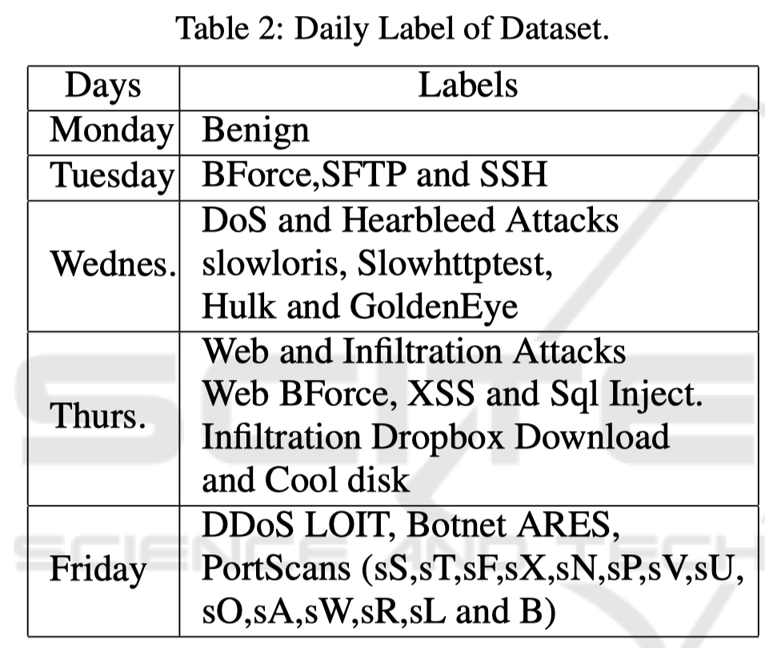
Labels
Benign
DoS GoldenEye
Heartbleed
DoS Hulk
DoS Slowhttp
DoS sloworis
SSH-Patator
FTP-Patator
Web-Attack
Infiltration
Bot
PortScan
DDoS
Notes:
The data capturing period started at 9 a.m., Monday, July 3, 2017 and ended at 5 p.m. on Friday July 7, 2017, for a total of 5 days.

Slide 5
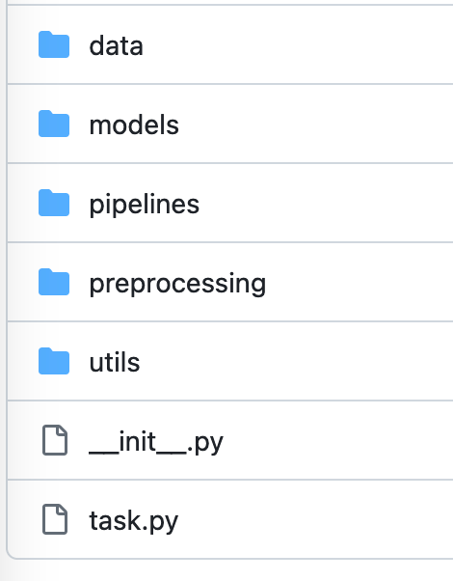
ML Pipeline
Preprocessing

Slide 6
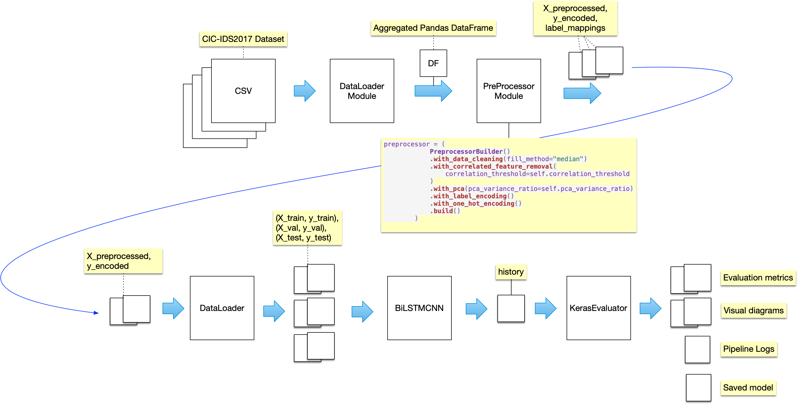
Notes:
Within the first 2 weeks of starting this project, I realized that a Notebook (Google Colab) wasn't going to cut it.
My Notebook(s) was getting really long. It was becoming difficult to locate information.
I started exploring alternative options like hosted MLOps platforms and came across Google Vertex. Vertex is a ML platform designed for training pipelines. I did a quick tutorial, and that led me to implementing my own custom ML pipeline.
The entire pipeline you see here is packaged as a PyPi artifact.
Users can control and interact with the tool using a CLI interface. You simply pip install it and run it by typing 'dosdetect' in the terminal.

Slide 7
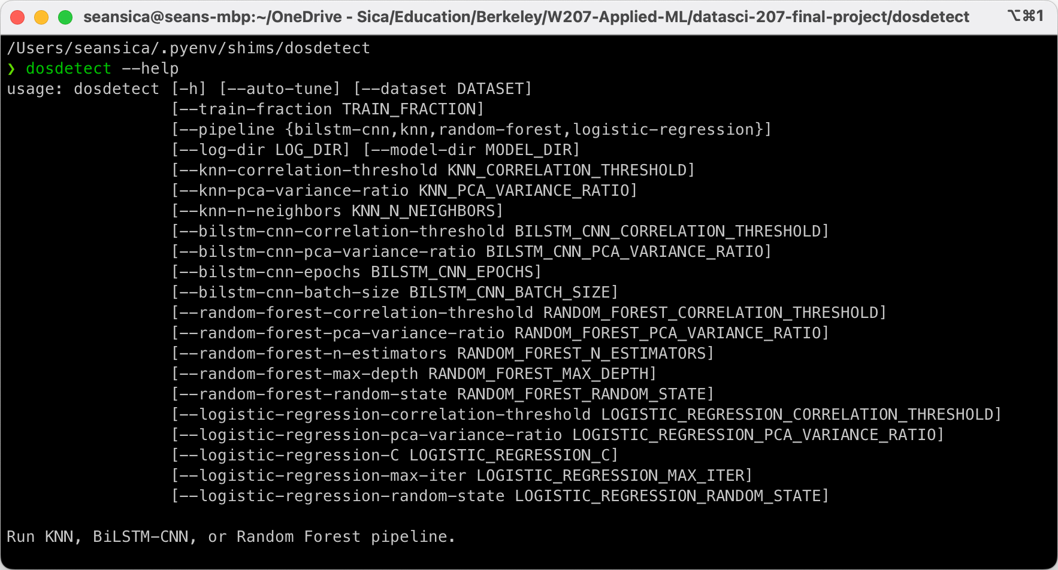
Notes:
PyPi package
CLI utility
23 configurable arguments
Supports BiLSTM-CNN, LR, RF, and KNN

Slide 8
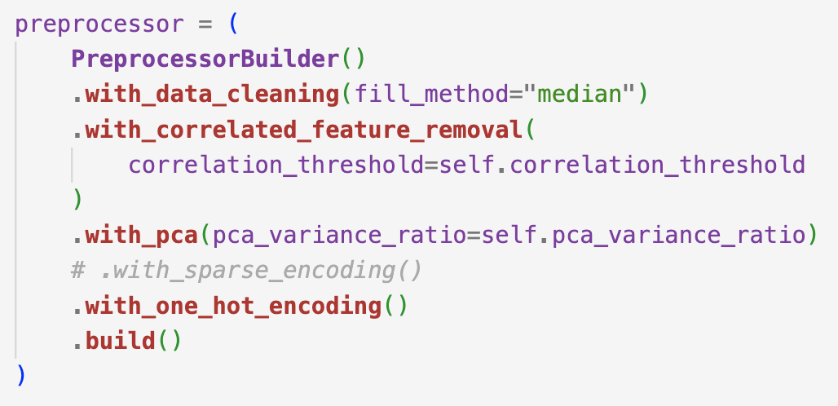
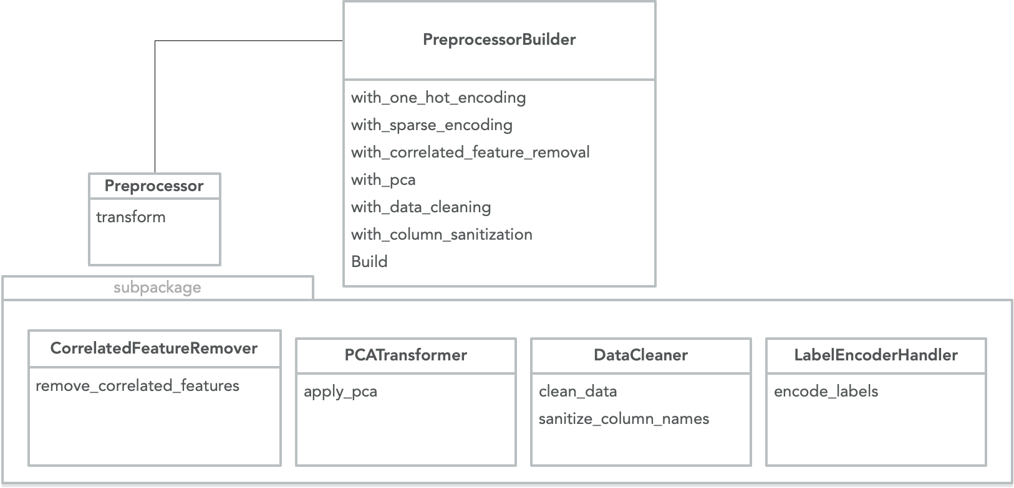
Data Analysis & Preprocesing
Preprocessor Builder
Data Cleaning
Dimensionality Reduction
Label Encoding
Notes:
Here is one of the more notable sub-packages included in the project. This was my approach to implementing a repeatable preprocessing pipeline that is modular and intuitive.
It follows the builder software pattern to make integration simpler and hides much of the underlying logic so the pipeline modules are short and sweet.
Worth noting that it supports two dimension reducing techniques which I'll cover next.

Slide 9
Dimensionality Reduction
"Naïve approach":
X.columns.drop(correlated_features)
Naïve (90%):
48 features
PCA (95%):
26 features
Combined:
24 features
Notes:
I originally started with what I call here the naïve approach.
In my EDA phase, I reduced the dimensionality by computing a correlation matrix and just dropped any features below a certain correlation threshold.
Later, I implemented PCA in my pipeline so I decided to keep both.
There are 79 features in the original dataset so PCA at a 95% threshold reduces the dimensionality by 67% which isn't very surprising given how many of the features like flow_duration and flow_bytes are inherently related.

Slide 10
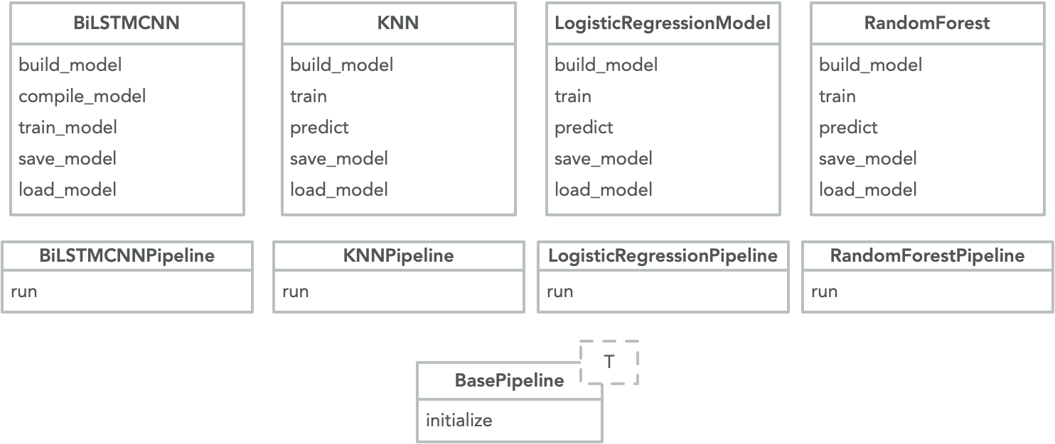
Extendable Pipeline
Notes:
My tool supports 4 unique models shown here. They share a base class called the BasePipeline to reduce code duplication.

Slide 11
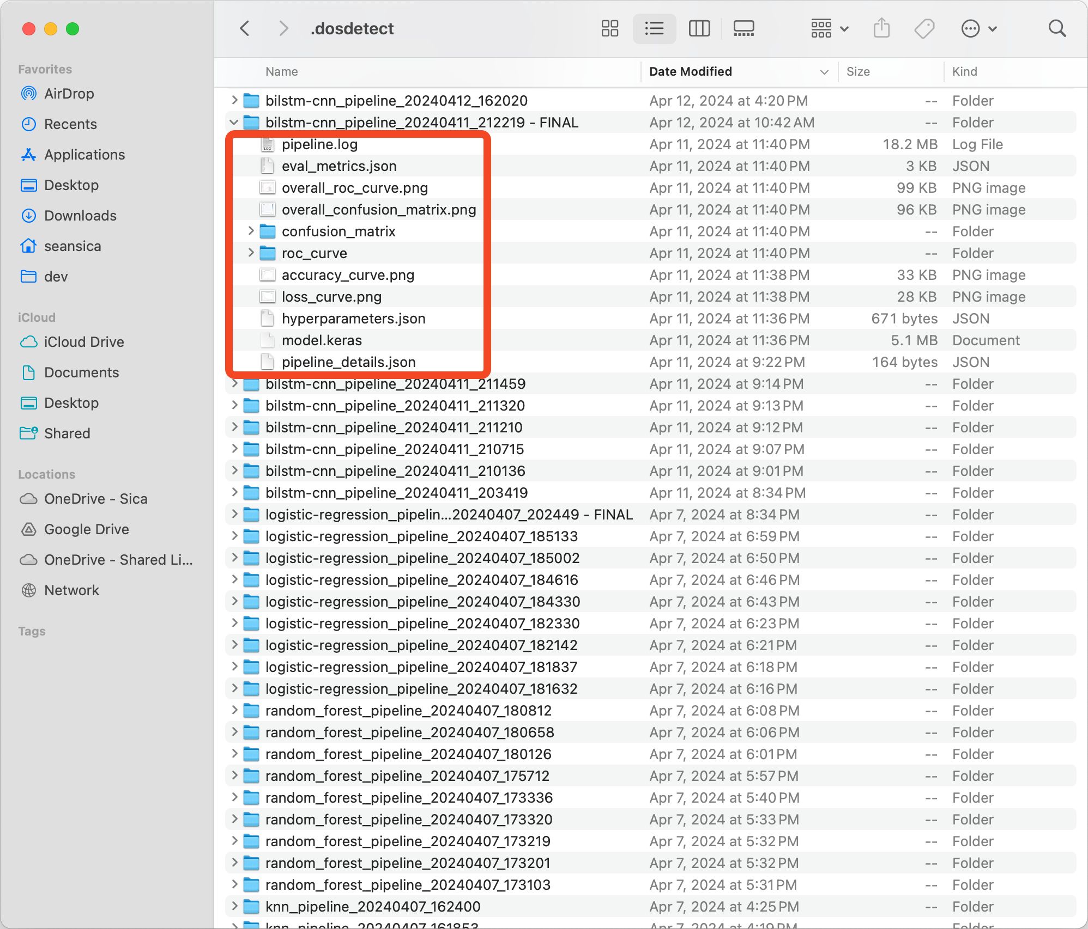
Notes:
And here is the coolest part, imo, of the entire program.
Every pipeline run generates a unique directory annotated with a timestamp.
Every log generated by the code is captured from stdout and stderr and redirected to a log file for future inspection. This allowed me to walk away during training without concern of not being able to track down thrown exceptions.
The model itself is also exported and saved to a file so I can load it into a Notebook for further evaluation.
In addition, details about the pipeline run such as the CLI flags and all of the hyperparameters used to train the model are saved.
Lastly, all of the evaluation metrics, including visualizations like ROC curves and accuracy curves are saved.
I think I have run the pipeline over 200 times now.

Slide 12
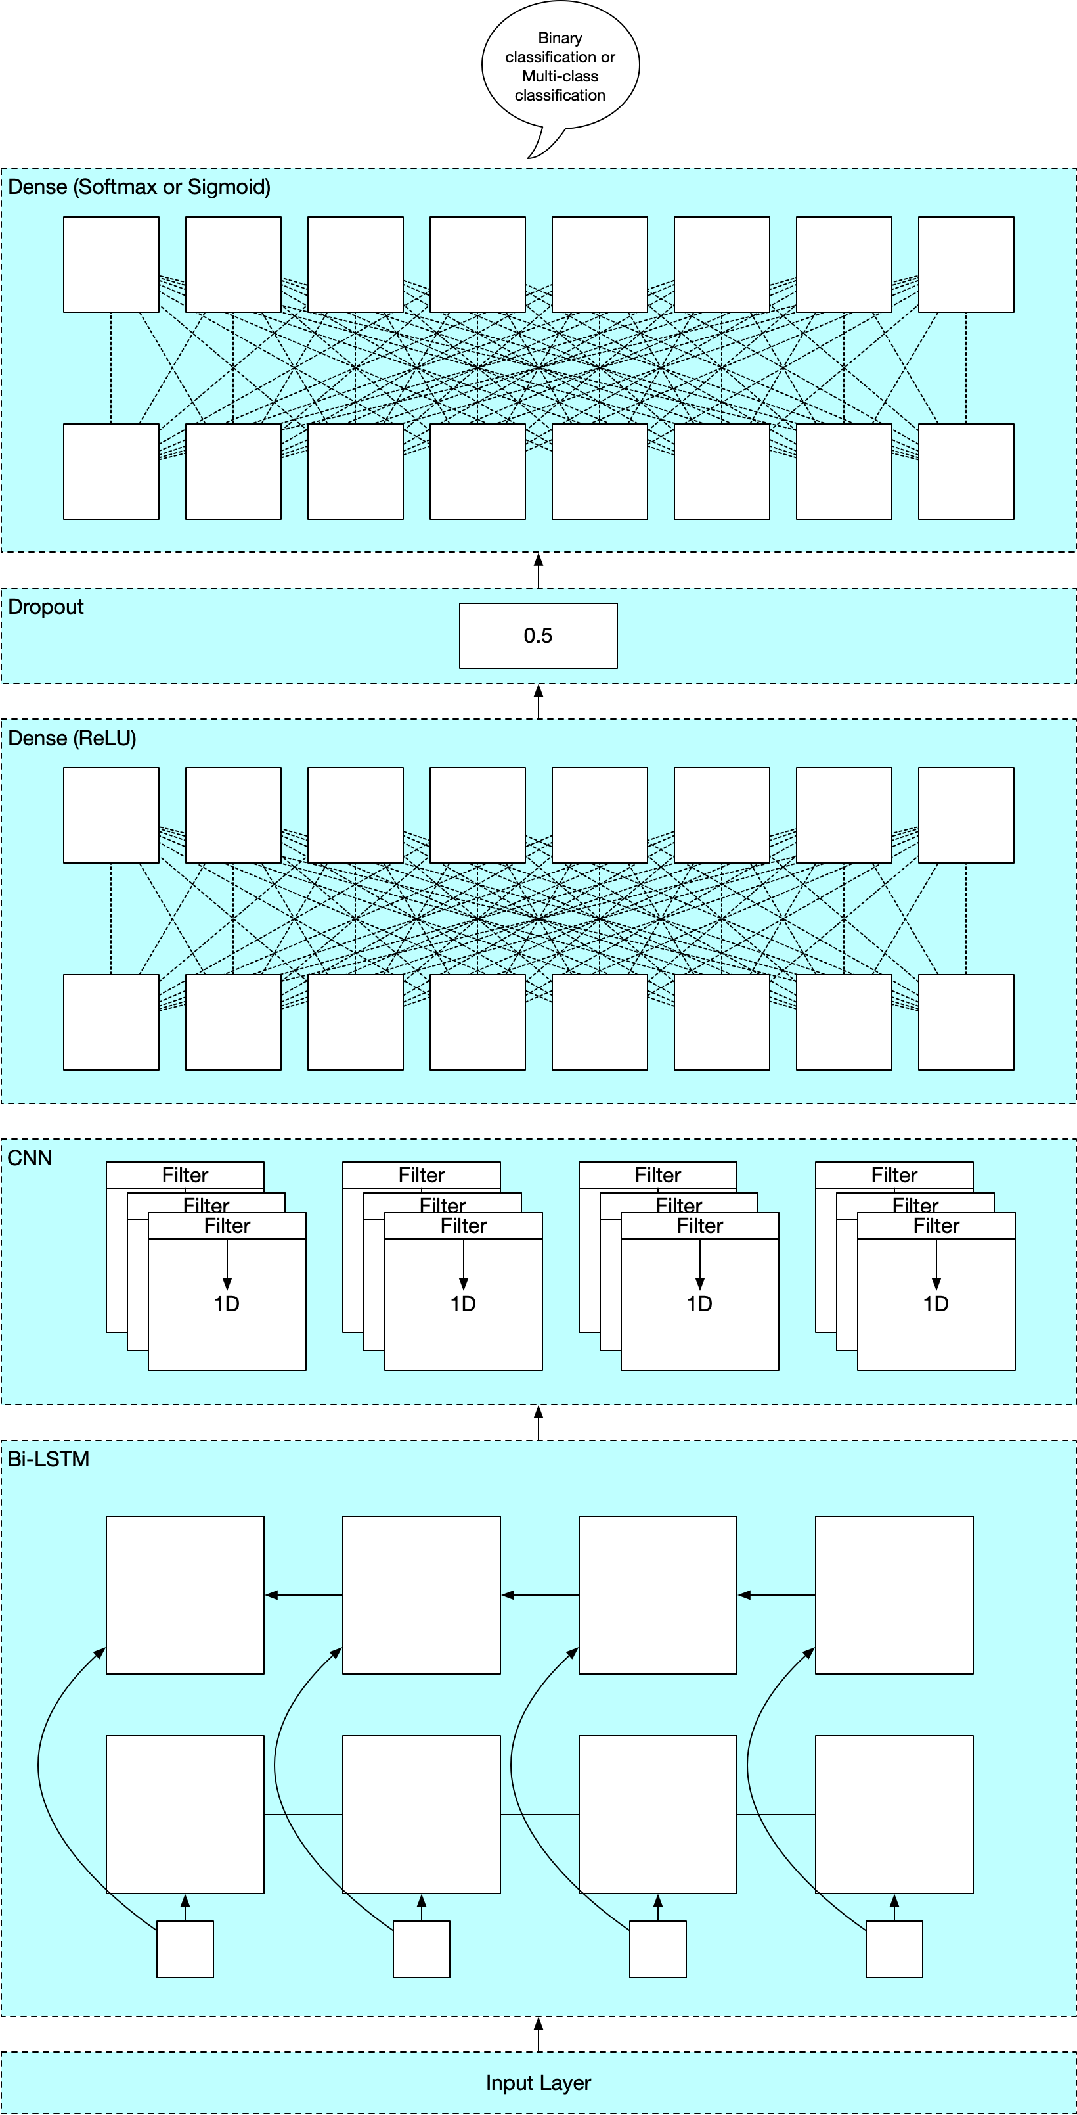
Model Architecture
2 Bidirectional LSTM layers (RNN)
Input layer
Conv1D + Flatten
Dense Layer + Dropout
Supports sigmoid + softmax
Notes:
Now let's get into the primary model of interest: the Bi-LSTM-CNN.
My choice of model was actually inspired by our professor, who co-wrote and published a research paper on the use of this model, though mine notably lacks the Attention mechanism layer that theirs references.
The model starts with two Bidrectional LSTM layers. This is really the heart of the operation. LSTM stands for "Long Short Term Memory" and are essentially more robust versions of a classical RNN model. They process the sequential data in both forwards and backwards direction.
The motivation behind processing the data in reverse is rooted in the nature of sequential data, where context can come from both the past and the future relative to a specific point in time. This is also partially true in language theory where the meaning of a word can be influenced by the words that come before it as well as the words that follow it.
Following the LSTM layers, a 1-dimensional convolution layer (or CNN) is used to distill the sequences into meaningful patterns, effectively spotlighting the nuances that the LSTM layers might have captured.
The output of the CNN is fed into a Flatten layer which acts as a bridge into the dense layers that come after. I chose ReLU for the activation.
Finally, there is a Dropout layer that helps prevent overfitting by randomly omitting neurons (or zeroing out weights) during training.
The model can be configured using both sigmoid and softmax. I only ended up using softmax but I had the idea late into the project to explore ensemble techniques by training individual binary classifiers.

Slide 13
Training & Evaluation
Training locally on macOS (bad)
Training on AWS EC2
• Platform: AWS EC2
• Instance Type: g5.12xlarge
– GPU: 4 units
– vCPU: 48 cores
– Memory: 192 GiB
Training: 12h+ --> 1h
Notes:
I did the majority of pipeline runs locally on M1 Pro.
I ad to reduce the size of the training set to lte 10% in order to train in a reasonably amount of time.
I actually ended up creating a configurable CLI argument (--train-fraction) to specify a percentage of the dataset to train on.
I moved to AWS for final "production" training.
The 4 GPU cores improved my training time from 12+ hours to around 1 hour for Random Forest and Bi-LSTM-CNN.
It's costs around $5.60/hour so I had to use it sparingly, so I actually did the vast majority of my developmental training locally on a Mac.

Slide 14
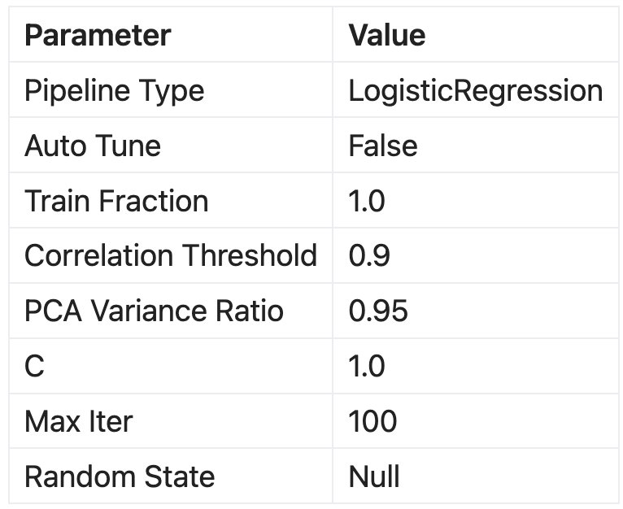
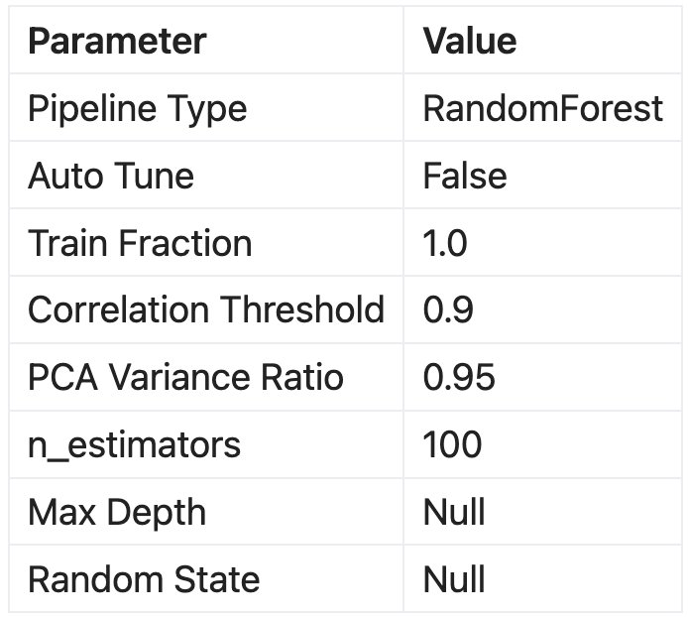
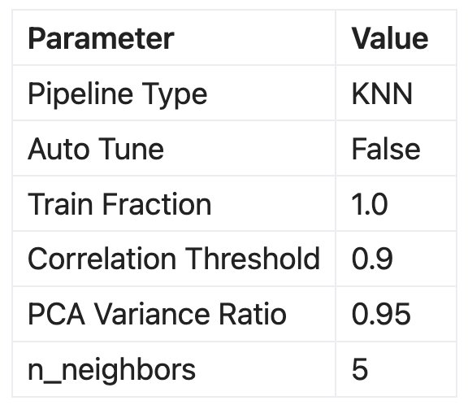
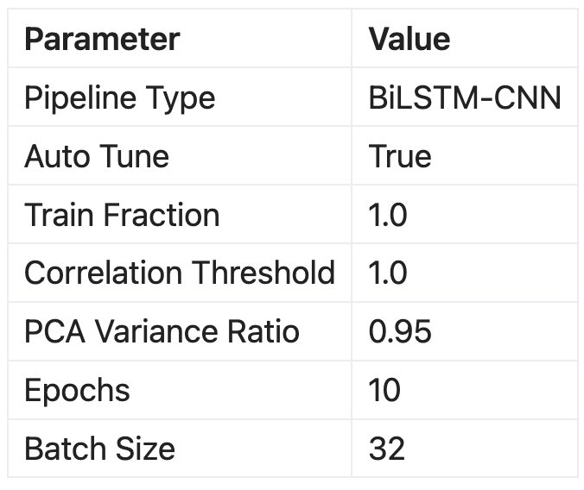
Notes:
Of the 200-ish pipelines that were run, these were the final contenders based on timing and overall performance
Notably, only the Bi-LSTM-CNN model was trained with Keras AutoTune because it was the only one that was built with Keras. The rest were SciKit Learn.
Also, the 3 baseline models used both the naïve dimensionality reduction technique AND PCA, so they were trained on even fewer features than Bi-LSTM-CNN.

Slide 15
Results & Insights

Slide 16
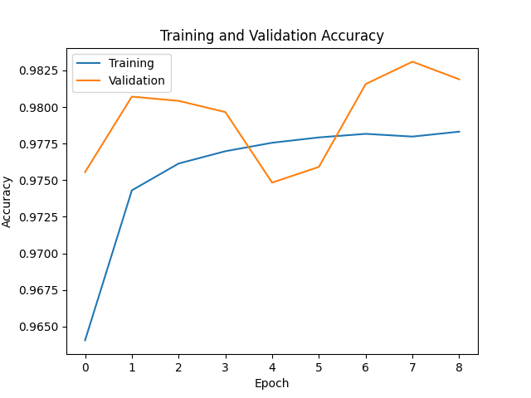
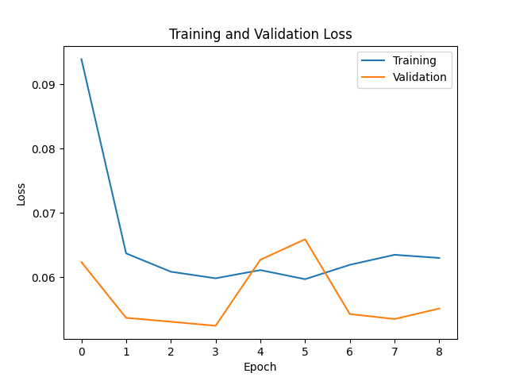
Check Overfitting
Notes:
Here are the Accuracy + Loss curves for Bi-LSTM-CNN
The high scores and marginal differences in training and validation suggest that we're not overfitting.

Slide 17
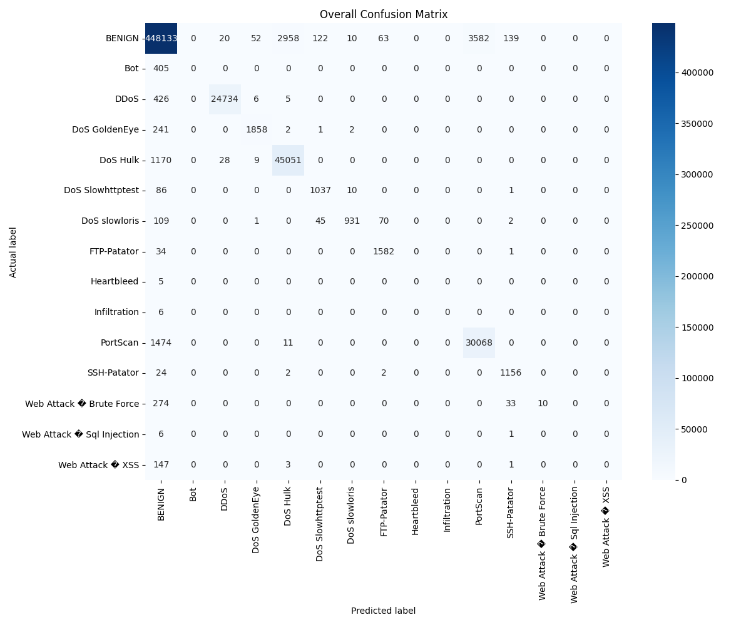
Notes:
Here is the Bi-LSTM-CNN confusion matrix for my test predictions
Notice that there are lots of False Negatives (traffic that should have been caught but wasn't!) — probably not a good idea to employ this in a production environment
In particular:
Lots of DoS Hulk predictions were actually Benign
Lots of PortScan predictions were actually Benign
A few SSH predictions were actually benign
Suggests possible strong correlations between these two classes that may necesitate more feature engineering

Slide 18
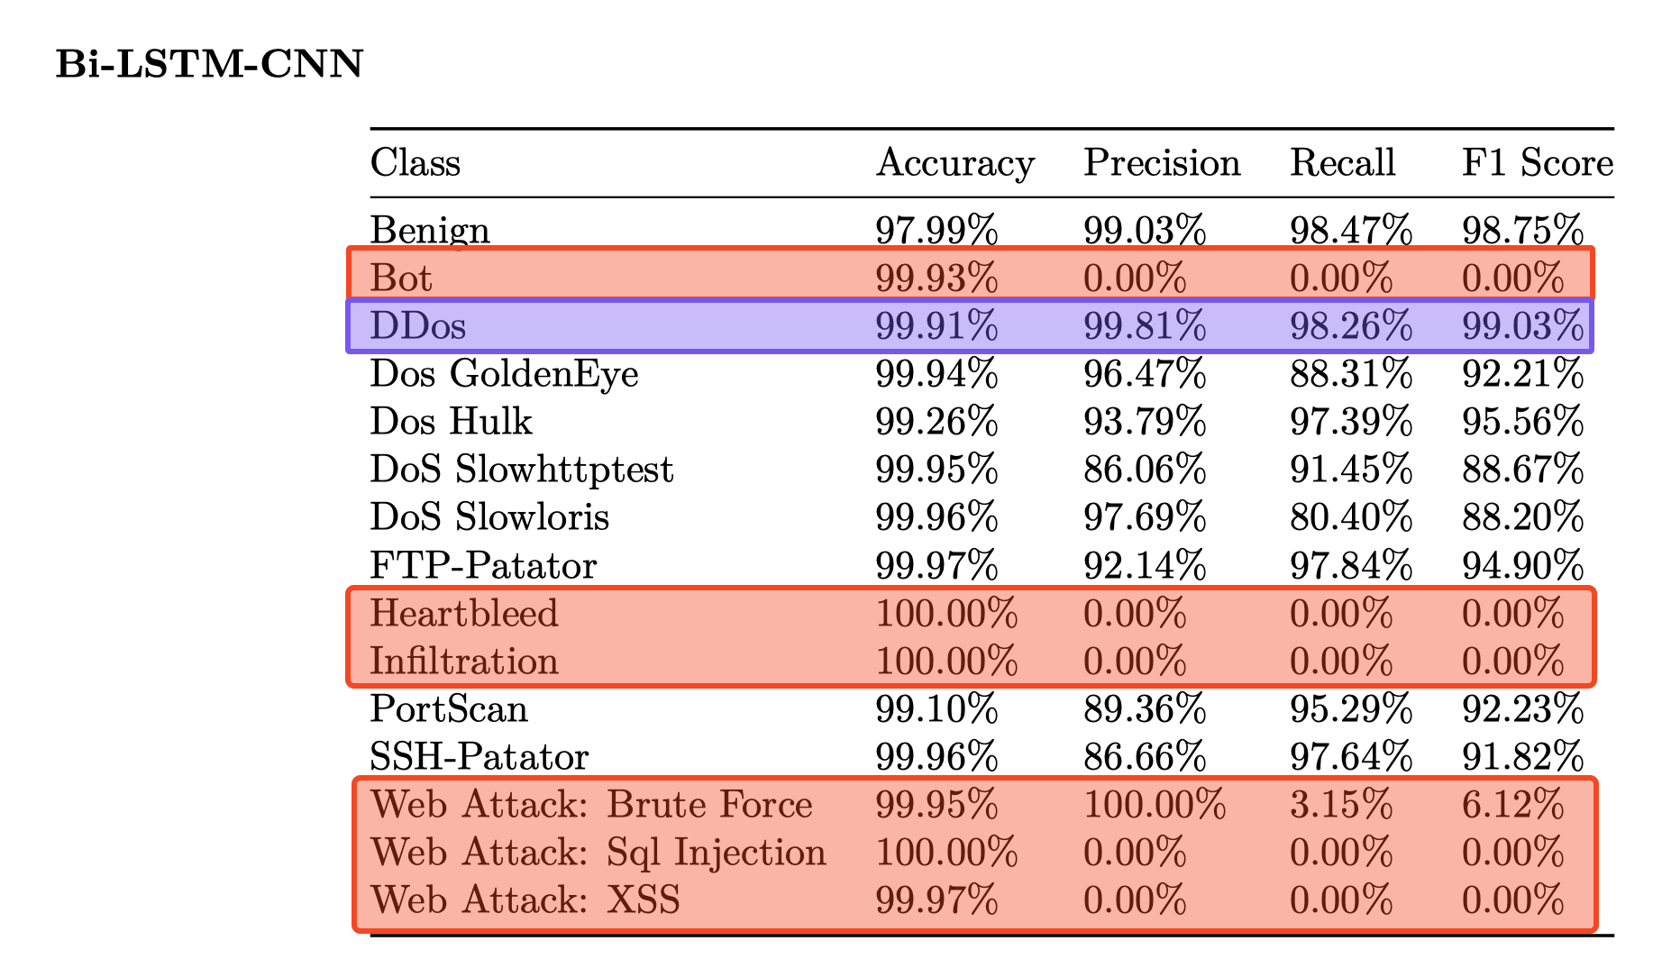
Notes:
Here are the evaluation results for my test data.
Highlighted in red are instances where Accuracy is close or at 100% while Precision, Recall, and F1 Score are at 0%. This can happen in cases where there is a significant class imbalance within the dataset.
In such instances, one class (usually the negative class—in this case BENIGN—) outnumbers the others. We know this to be true in our dataset given how dominate the Benign class by nature.
So, it's probable that the model is not learning to classify the minority class effectively. This echos the False Negatives we observed in the confusion matrix earlier.

Slide 19
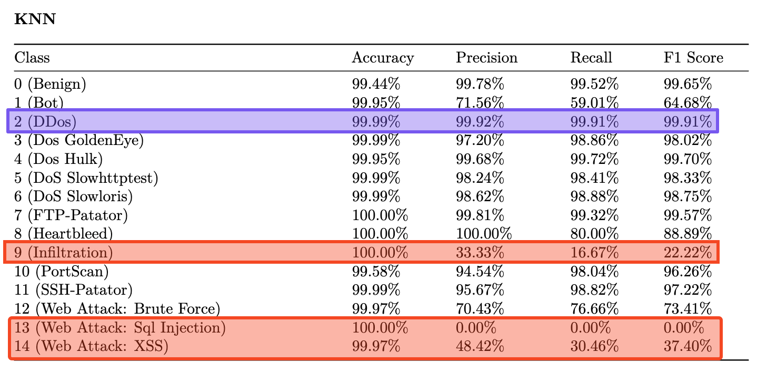
Notes:
Here are the eval metrics for KNN.
DDos performed higher than Bi-LSTM-CNN.
It similarly performed poorly on the disparate classes shown in red, though it appears it was actually slightly more resilient than the LSTM model.
The regular or non-distributed DoS scores are high across the board

Slide 20
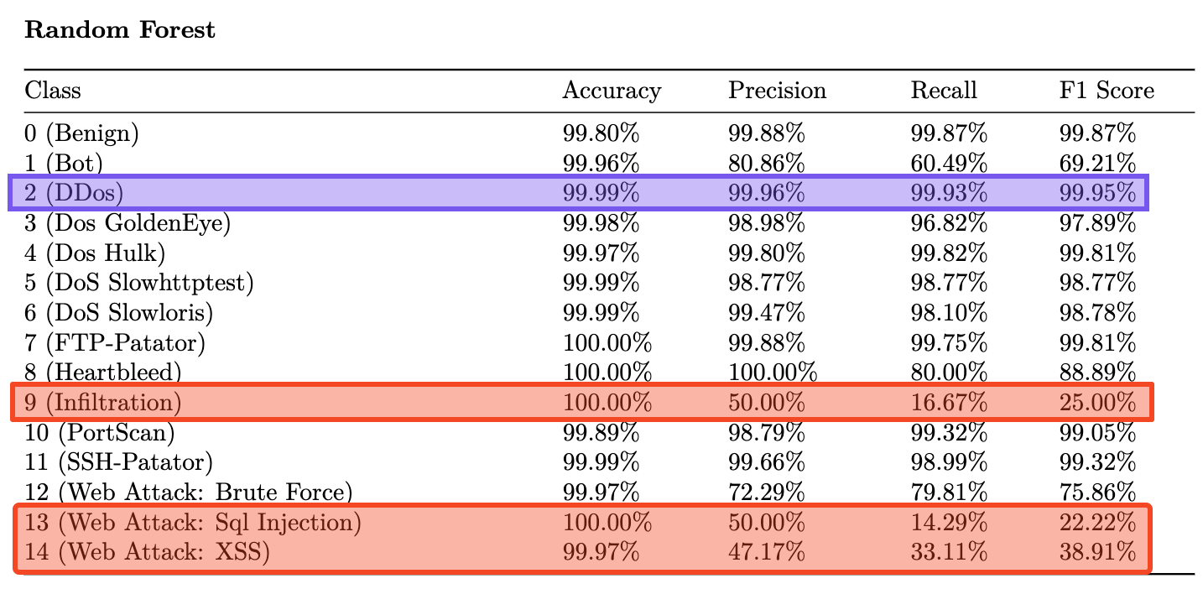
Notes:
Random Forest has very similar results as KNN. This was the top performer of all of the models. Again, it suffers from the same issues discussed earlier.

Slide 21
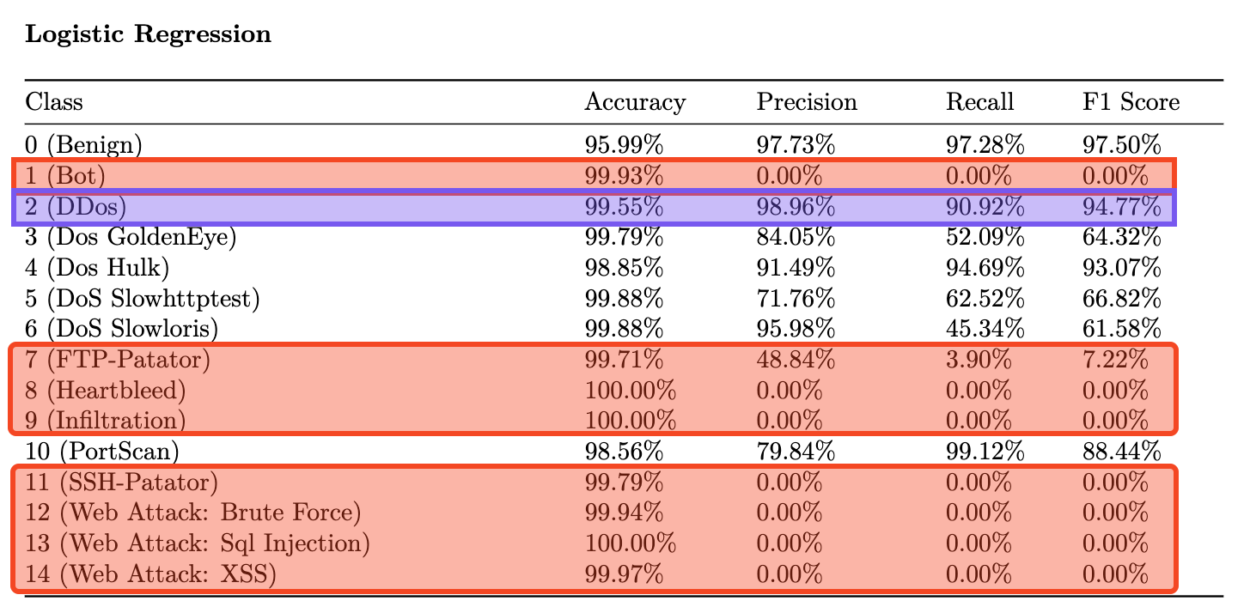
Notes:
The worst performer was Logistic Regression.
Though it is worth pointing out that it is the easiest of all to train. I believe it only took 2 minutes to train on CPU. So the DDoS scores are actually pretty impressive all things considered.

Slide 22
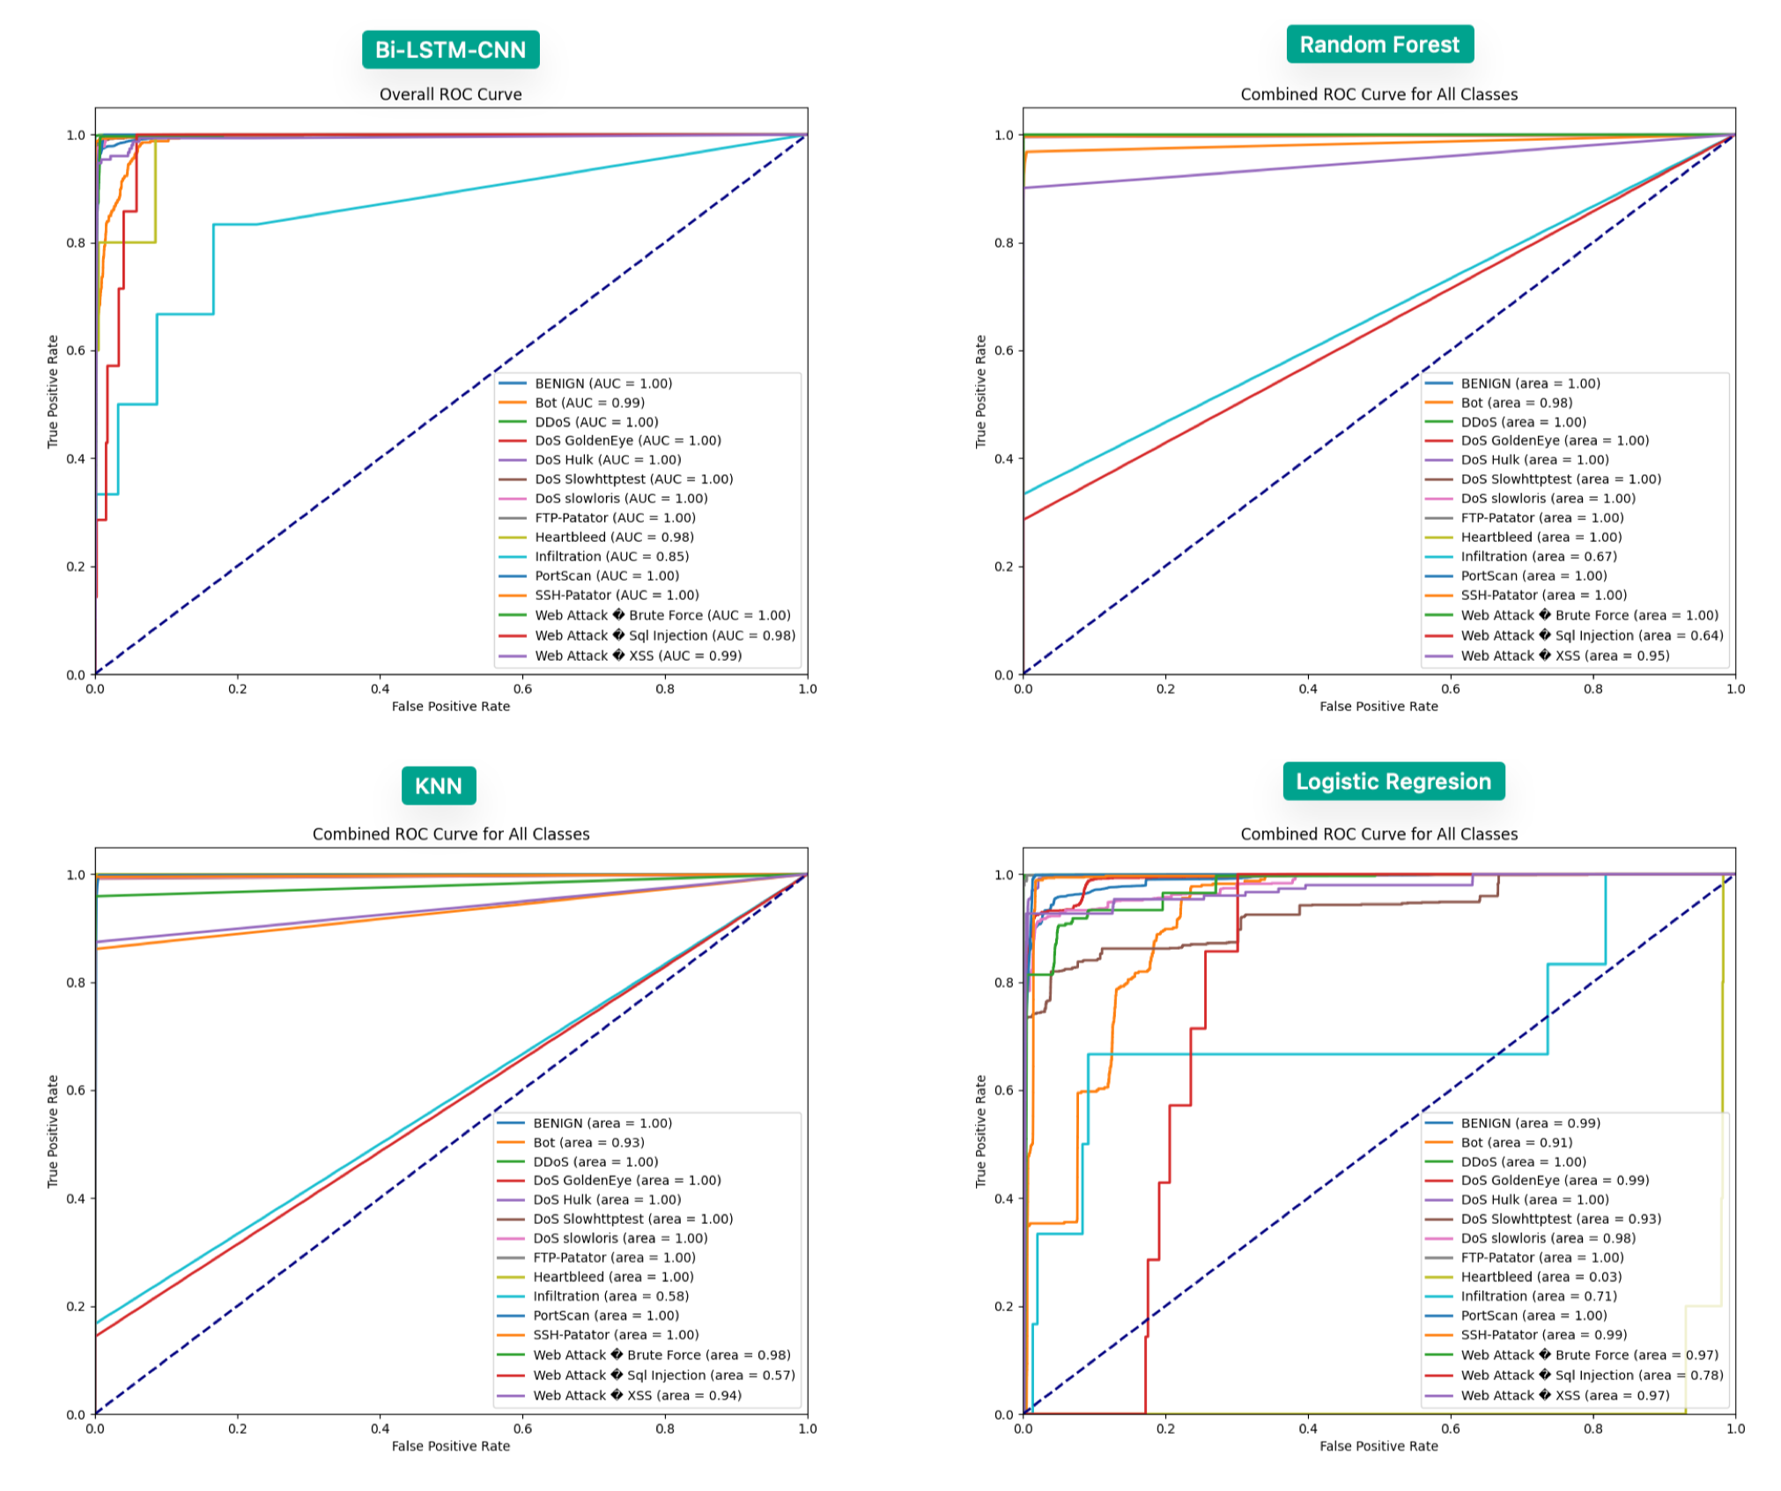
Notes:
These are the last evaluation metrics I'll show you guys today.
Here are the ROC (receiver operating characteristics) curves for each of the models.
They are created by plotting the True Positive Rate (TPR, also known as recall) against the False Positive Rate (FPR) at various threshold settings.
A higher AUC value indicates better model performance for that class.
They essentially show what we already discussed:
Bi-LSTM-CNN and RF model demonstrated almost perfect classification for most classes.
The KNN model did well overall, but smaller classes like 'Heartbleed' and 'Web Attack' were not captured as well.
Logistic Regression showed the most variation in performance.

Slide 23
Conclusions
Bi-LSTM-CNN reasonably good multi-class prediction choice for sequential networking data
Further performance gains could be achieved with more feature engineering.
RF and KNN are surprisingly performant and robust/resilient to class imbalance; nearly as good or better predictors than Bi-LSTM-CNN.
LR not very good, but cheap and surprisingly ~okay~

Slide 24
Limitations & Future Work
Dataset Dependence
Class Imbalance
Lack of Attention Mechanism
Hardware Limitations
Future Implementations
SaaS (API access)
Practical data ingest formats (PCAP)
GPU Acceleration (SciKeras)
Ensemble Models
Visualizations of CNN feature maps

Slide 25
Questions and Answers
The End!

